Slide 1
Faculty of Mathematics and Physics
Charles University
Game User Experience
Lecture 11

Slide 2
Practical info
Second Large Assignment
Two smaller assignments left
Missing materials till 14.1.
Exam + debriefing

Slide 3
Shared Document
Let‘s go to the g-doc https://docs.google.com/spreadsheets/d/1S224KOCIWKzA_WloW1wx3kx8IBXlc33VQ1ihAeZIDoY/edit?usp=sharing
(Link in the Discord)

Slide 4
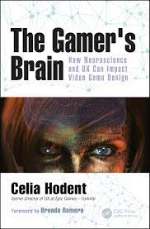
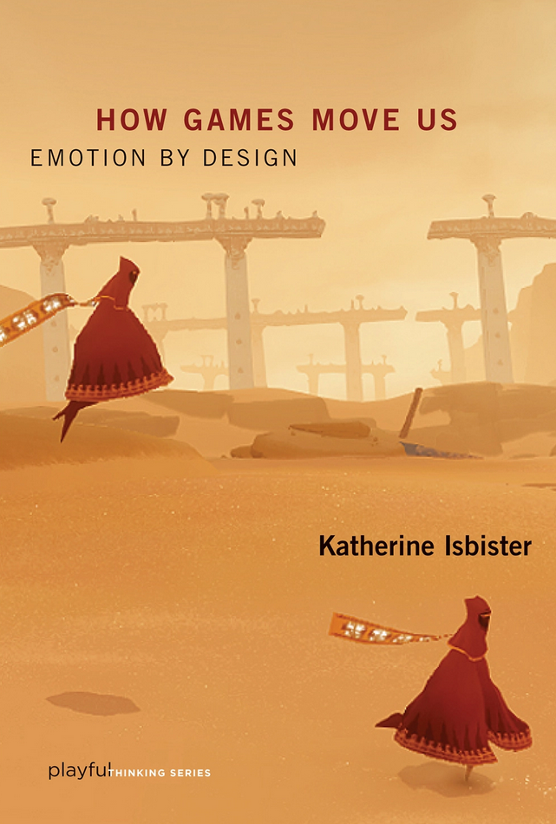
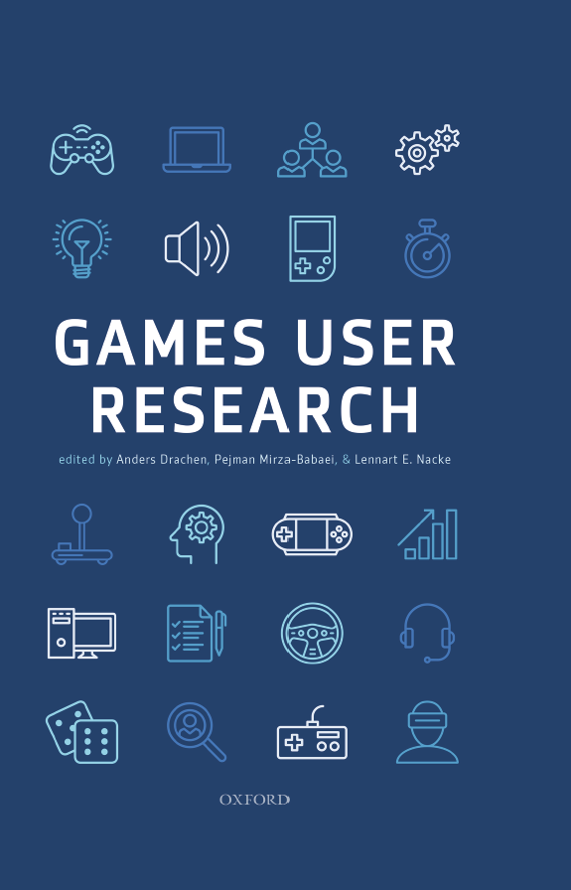
Emotions

Slide 5
Emotions
Emotion is a state of physiological arousal, and it can also involve the cognition related to this state of arousal
Notes:
It is a developers account – I am collecting data only from a certain population – probably gamers, somehow focused on some types of games
Response bias - where there’s something about how the actual survey questionnaire is constructed that encourages a certain type of answer, leading to measurement error.

Slide 6
Why important?
Motivate and guide
Discrete emotions have adaptive functions
Perception and cognition can influence emotions
Emotions can guide cognition
Notes:
It is a developers account – I am collecting data only from a certain population – probably gamers, somehow focused on some types of games
Response bias - where there’s something about how the actual survey questionnaire is constructed that encourages a certain type of answer, leading to measurement error.

Slide 7
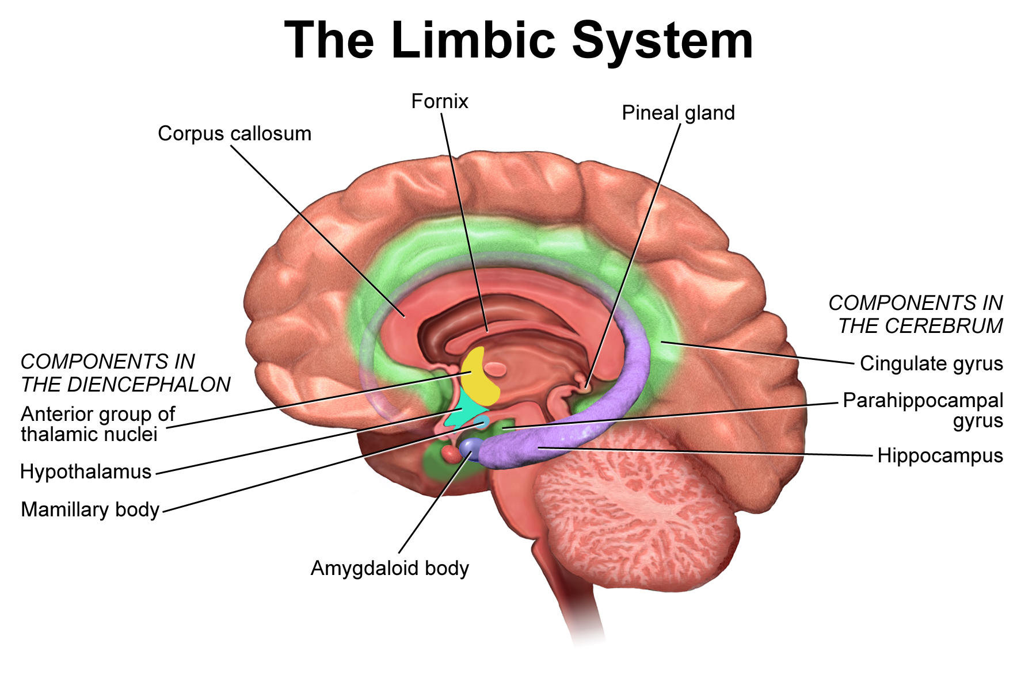
Emotions
Source:
Source: wiki (2021)

Slide 8

The Somatic Markers Hypothesis
Feelings associated with emotions
Strongly influence subsequent decision-making
„Gut feelings“ and „intution“
originate from these feelings
Source:
Antonio Damasio Source: Twitter (2021)
Notes:
It is a developers account – I am collecting data only from a certain population – probably gamers, somehow focused on some types of games
Response bias - where there’s something about how the actual survey questionnaire is constructed that encourages a certain type of answer, leading to measurement error.

Slide 9


Misattribution of the physiological arousal
Experiment conducted by Dutton and Aron 1974)
Source:
Stable bridge Source: wiki (2021)
Source:
Suspension bridge Source: cntraveler.com (2021)
Notes:
It is a developers account – I am collecting data only from a certain population – probably gamers, somehow focused on some types of games
Response bias - where there’s something about how the actual survey questionnaire is constructed that encourages a certain type of answer, leading to measurement error.

Slide 10
Limited knowledge
Emotion serves motivation
Emotion can enhance cognition
Emotion can impair reasoning and cognition
Misatribution of emotional arousal
and its extention to the whole situation
Notes:
It is a developers account – I am collecting data only from a certain population – probably gamers, somehow focused on some types of games
Response bias - where there’s something about how the actual survey questionnaire is constructed that encourages a certain type of answer, leading to measurement error.

Slide 11
Implications for games?
Source:
Giphy.com (2021)

Slide 12
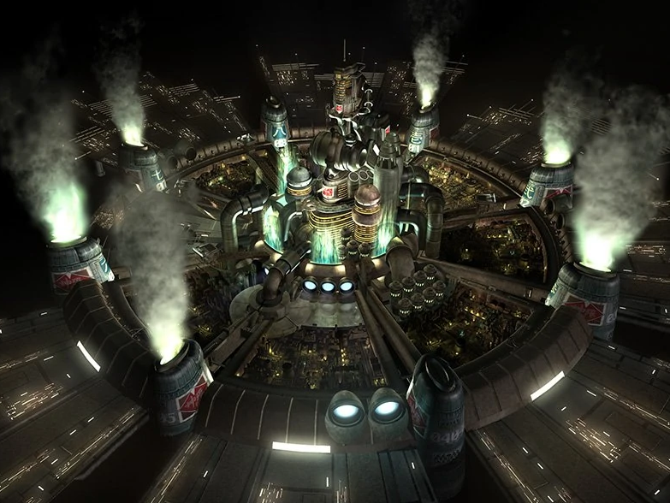
Sound examples
Final Fantasy VII (Square Enix 2021)
Notes:
It is a developers account – I am collecting data only from a certain population – probably gamers, somehow focused on some types of games
Response bias - where there’s something about how the actual survey questionnaire is constructed that encourages a certain type of answer, leading to measurement error.

Slide 13
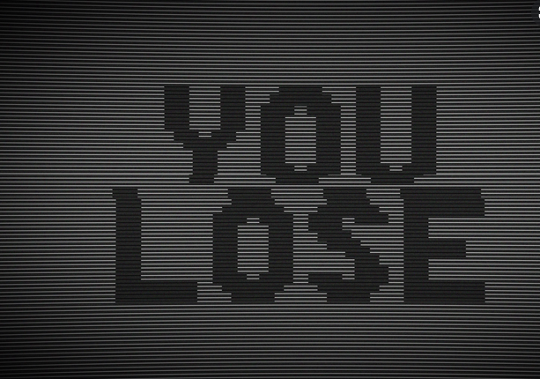
Loosing and Games
Notes:
It is a developers account – I am collecting data only from a certain population – probably gamers, somehow focused on some types of games
Response bias - where there’s something about how the actual survey questionnaire is constructed that encourages a certain type of answer, leading to measurement error.

Slide 14
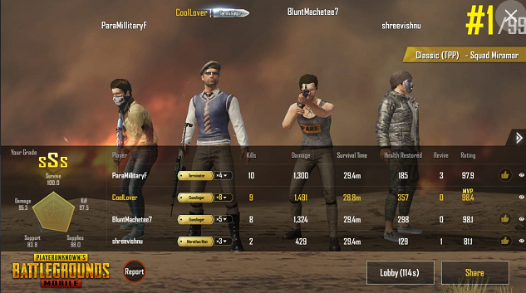
Loosing and Games
PUBG Mobile (Lightspeed & Quantum, PUBG Corporationx 2018)
Notes:
It is a developers account – I am collecting data only from a certain population – probably gamers, somehow focused on some types of games
Response bias - where there’s something about how the actual survey questionnaire is constructed that encourages a certain type of answer, leading to measurement error.

Slide 15
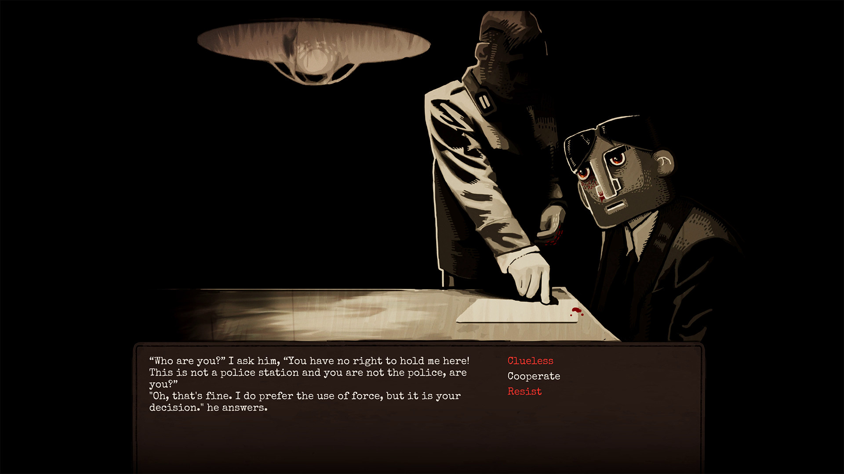
Why are games unique?
Through the Darkest of Times
(Paintbucket Games, 2020)
Notes:
It is a developers account – I am collecting data only from a certain population – probably gamers, somehow focused on some types of games
Response bias - where there’s something about how the actual survey questionnaire is constructed that encourages a certain type of answer, leading to measurement error.

Slide 16
Unique emotions
Let‘s go to the g-doc https://docs.google.com/spreadsheets/d/1S224KOCIWKzA_WloW1wx3kx8IBXlc33VQ1ihAeZIDoY/edit?usp=sharing
(Link in the Discord)

Slide 17
Why are games unique?
Through the Darkest of Times
(Paintbucket Games, 2020)
Notes:
It is a developers account – I am collecting data only from a certain population – probably gamers, somehow focused on some types of games
Response bias - where there’s something about how the actual survey questionnaire is constructed that encourages a certain type of answer, leading to measurement error.

Slide 18
Game Feel
According to game designer Steve Swink (2009), the game feel includes, “Feelings of mastery and clumsiness, and the tactile sensation of interacting with virtual objects” (p. 10).
Notes:
It is a developers account – I am collecting data only from a certain population – probably gamers, somehow focused on some types of games
Response bias - where there’s something about how the actual survey questionnaire is constructed that encourages a certain type of answer, leading to measurement error.

Slide 19
Game Feel
3Cs – Control, Camera, Character
Presence (physical, emotional, narrative)
Physical reality and living virtual worlds
Notes:
It is a developers account – I am collecting data only from a certain population – probably gamers, somehow focused on some types of games
Response bias - where there’s something about how the actual survey questionnaire is constructed that encourages a certain type of answer, leading to measurement error.

Slide 20
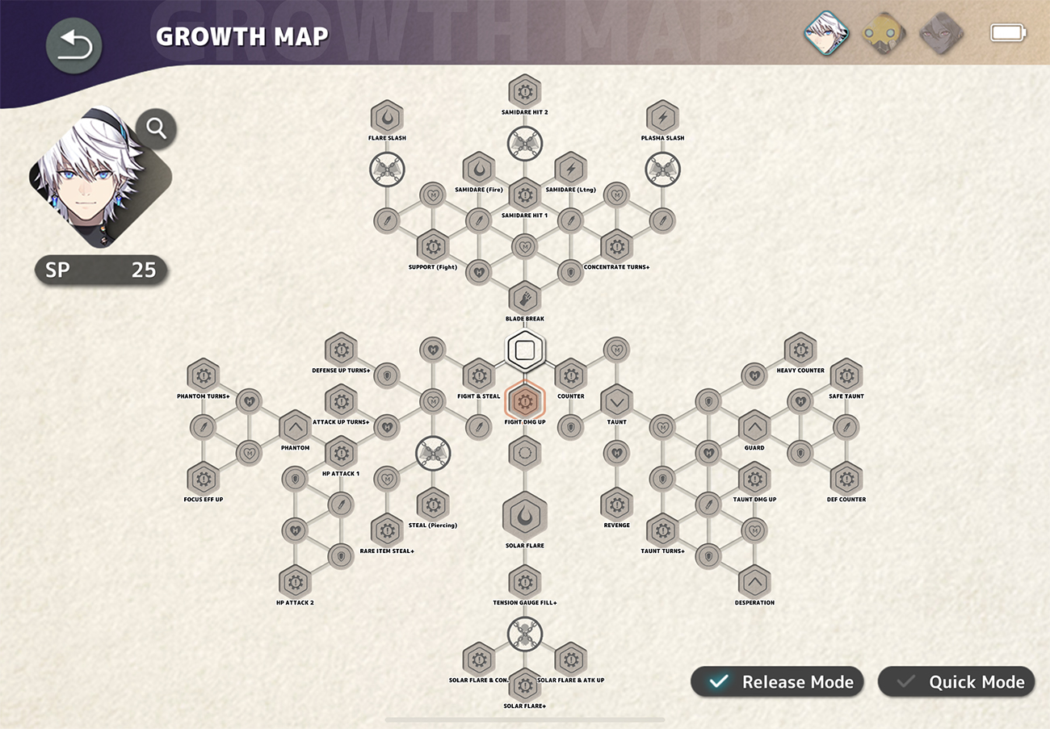
Progressively introducting new elements
Fantasian (Mistwalker, 2021)
Notes:
It is a developers account – I am collecting data only from a certain population – probably gamers, somehow focused on some types of games
Response bias - where there’s something about how the actual survey questionnaire is constructed that encourages a certain type of answer, leading to measurement error.

Slide 21
PANAS
Fantasian (Mistwalker, 2021)
Notes:
It is a developers account – I am collecting data only from a certain population – probably gamers, somehow focused on some types of games
Response bias - where there’s something about how the actual survey questionnaire is constructed that encourages a certain type of answer, leading to measurement error.

Slide 22
Summary
What are emotions and their functions
Misattribution of the physiological arousal
Emotional arousal extended to the whole situation
What is unique about games and some implications for games from the above mentioned
Game feel and novelty in games
PANAS

Slide 23
Faculty of Mathematics and Physics
Charles University
In case of questions:
kolek@ksvi.mff.cuni.cz
Stay in touch on Discord

